Slide 1

SEB DATA CHALLENGE
BARTOSZ PIECHNIK, 2023-03-16

Slide 2
SETUP
Anaconda
Git
GitHub
Jupyter Notebooks
Python 3.11
pandas
seaborn
scikit-learn

Slide 3
DATA PREPARATION - checks
Unique IDs (database consistency)
'Nan' values
Remove
Replace
Outliers
Weird values "?"
Domain sense
Appropriate data types

Slide 4
DATA PREPARATION – clean-up
Convert 'NaN's to zeros in customers['LOAN'] column
Remove 5000 duplicates in transactions['TRANS_ID'] column
Remove 5000 orphan values in transactions['ACCOUNT_ID' column
Convert 180k 'Nan' values to 'CREDIT_TO_CC' tag in transactions['OPERATION'] column
Remove 14 transactions with zero value in transactions['AMOUNT'] column
Replace one row with '?' Value in districts['UNEMP95'] and districts['UNEEMP95'] columns

Slide 5
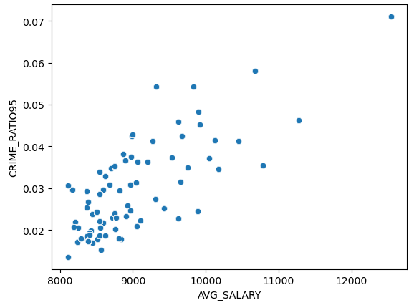
DATA ANALYSIS
district with highest crime ratio (nr of crime incidents / districts population) is District 1, most likely Stockholm
contrary to common intuition, there is no correlation between crime rate and unemployment rate
high crime ratio is correlated with high population, high population density and high average salary

Slide 6
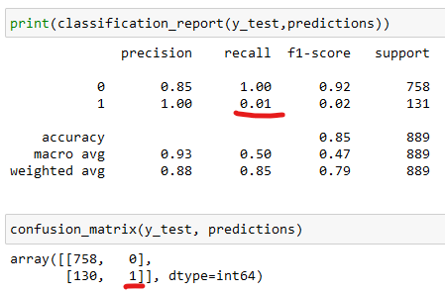
LOGISTIC REGRESSION
Possible reasons for poor model performance:
Train data set is disbalanced (85% '0' vs 15% '1')
Logistic regression don't perform well with disbalanced sets, which is apparent in the recall for '1'. Only 1% of true negatives were predicted (model marked almost all items as '0')
Possible improvements for the model include:
use resampling methods (undersample 'no loans' set or oversample the 'loans' set).
use algorithms which perform better on unbalanced sets like Support Vector Machine or Random Forest.

